Slide 1
Data Quality
Defintion #1: “Fitness for Use”
Degree to which data can be used for its intended purpose
Definition #2: “Real-World Representation”
Degree to which data accurately represents the real world
We can try to satisfy BOTH definitions!

Slide 2
Data Quality: Measures
Completeness: Do we have all the data we expect to have?
Are all events captured?
Are all attributes of an event captured?
Are all values of reference data accounted for?
Uniqueness: Are single events captured only once?
Accuracy: Is the data a true representation of the idea it’s trying to capture?
Are numbers and string values correct?
Are timestamps and other attributes correctly captured?
Consistency: Do I capture the same data the same way every time? Do I capture it the same in each place?

Slide 3
Data Quality: Measures
Conformance / Validity: Does stored data conform to syntax, encoding, or other model specifications?
Are data formats correct?
Are codes as expected?
Are naming conventions adhered to?
Timeliness: Is data available by the time it is needed?
Also referred to as “Data Latency”
Provenance: Do we have visibility into the origins of the data?
How much confidence do we have that the data is real and accurate?

Slide 4
The Information-Action Value Chain
Real-World Events & Characteristics
System Data Capture
Accessible Location / Storage
Data Extraction for Analysis

Slide 5


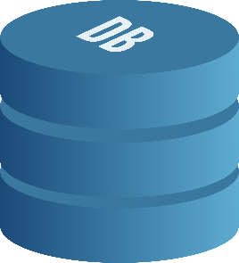
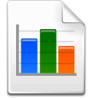
Data Quality: Process
(1) Fix quality issues before / as they are captured
1
(4) Detect / fix issues in report or analysis
(2) Detect / fix issues inside source system
5
2
Capture
Sources
ETL
Reporting & Analysis
Detect / fix issues in ETL:
- Audit, Balance & Control
Standardize during load
“Referential Integrity”
3
(4) Detect / fix issues inside database
(4) Eyeball Check!
4
Feedback & Process to Remediate and Improve – Using ALL touchpoints!

Slide 6
Recap
“Fitness for Use” and “Real-World Representation” Definitions
Measures:
Completeness / Uniqueness
Accuracy / Consistency
Conformance / Validity
Timeliness
Provenance
Data Quality Process

